Slide 1





Disclosing the heat density of centralized heat networks under the 1.5°C climate target
Sebastian Zwickl-Bernhard¹, Daniel Huppmann², Antonia Golab¹, Hans Auer¹
¹Energy Economics Group (EEG), Technische Universität Wien
²International Institute for Applied Systems Analysis
Parallel Session 4: Improving Integration and Efficiency (Day 1)
Corresponding author/Presenter: zwickl@eeg.tuwien.ac.at
This presentation is licensed under a Creative Commons Attribution 4.0 International License

Slide 2
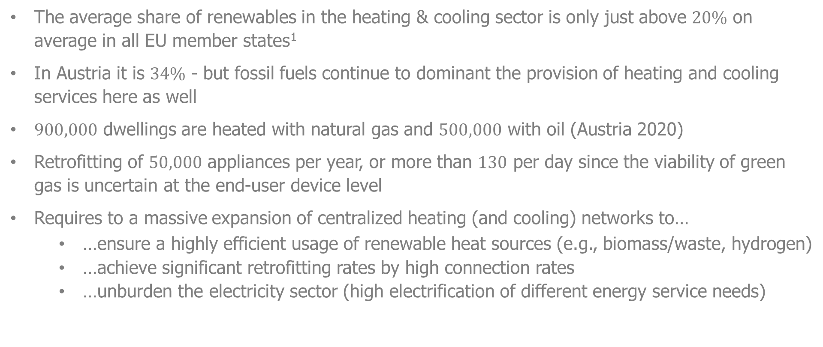
Current state of the European heating sector
The average share of renewables in the heating & cooling sector is only just above $20\%$ on average in all EU member states¹
In Austria it is $34\%$ - but fossil fuels continue to dominant the provision of heating and cooling services here as well
$900,000$ dwellings are heated with natural gas and $500,000$ with oil (Austria 2020)
Retrofitting of $50,000$ appliances per year, or more than $130$ per day since the viability of green gas is uncertain at the end-user device level
Requires to a massive expansion of centralized heating (and cooling) networks to…
…ensure a highly efficient usage of renewable heat sources (e.g., biomass/waste, hydrogen)
…achieve significant retrofitting rates by high connection rates
…unburden the electricity sector (high electrification of different energy service needs)
¹Eurostat https://ec.europa.eu/eurostat/web/products-eurostat-news/-/ddn-20200211-1
Notes:
I start this presentation with a brief overview of the European heating sector. So far, fossil-fuel based heat generation dominates the supply of heat service needs. The share of renewable energy in the provision of heating and cooling services is only just above 20% on average in all EU member states. In Austria, it is 34%. However, fossil fuels continue to dominant here as well. To be more precise, 1.4 million dwellings are heated with natural gas or oil in Austria today. Switching these heating systems to renewable energy by 2050, retrofitting 50 thousand end-user devices per year or more than 130 per day becomes necessary. To achieve this goal, we need not only sustainable decentralized heating systems, but also a massive expansion of centralized heating and cooling networks. In particular, district heating networks will play a crucial role as they (i) ensure a highly efficient usage of renewable heat sources, such as biomass/waste and hydrogen; (ii) give us the opportunity to achieve significant retrofitting rates by high connection rates; and (iii) can unburden the electricity sector as we expect high electrification rates of different energy service needs, such as in the transport and industry sector.

Slide 3
The core objective of this work
The core objective of this work is downscaling European decarbonization scenarios¹ of the heating sector to the community/distribution grid level serving end-users in 2050.
In particular, downscaling considers the highly efficient and local use of sustainable heat sources in centralized heat networks (e.g., co-firing hydrogen in cogeneration plants and large-scale waste utilization, etc.).
In addition, the topography of district heating networks is of particular importance and plays a crucial role in applied downscaling.
This allows estimates of realistic and cost-effective decarbonized district heating networks in 2050 to be obtained, which can be compared with existing networks. Thereby, the heat density of district heating networks serves as a comparative indicator and permits a rough estimation of the changes needed for centralized heating networks considering the 1.5°C climate target.
An Austrian case study is conducted, downscaling the results of the heating sector in 2050 from the large numerical energy system model GENeSYS-MOD², from the country to the community/distribution grid levels.
¹Developed in the European H2020 project openENTRANCE aiming for the 1.5/2.0°C global warming climate target
²Löffler et al., Energies, (2017). doi: 10.3390/en10101468
Notes:
Against this background, the core objective of this work is the downscaling of decarbonization scenarios of the heating sector, taking into account the infrastructure/network requirements of heat generation technologies/sources, from the country to the community level. In particular, the prioritized preference of heat sources in centralized heat networks plays a crucial role, ensuring highly efficient usage of heat sources. Moreover, the assessment of centralized or district heating networks using heat density as a criterion is important in this analysis. We conduct an Austrian case study, downscaling cost-minimizing heat generation portfolios 2050, obtained from the large numerical energy system model GENeSYS-MOD, from the country to the grid level.

Slide 4
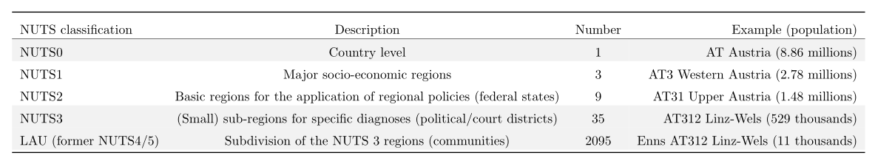
Methodology
Three different scenario-independent downscaling techniques
Proportional downscaling using population as a proxy (NUTS0 to the LAU level)
Sequential downscaling algorithm using population density and infrastructure requirements of heat technologies/sources as additional criterion (NUTS0 to the NUTS3)
Iterative downscaling algorithm based on graph-theory benchmarking (NUTS3 to the LAU level)
Reference technique
Techniques developed
The Nomenclature of Territorial Units for Statistics (NUTS) were created by Eurostat in order to define territorial units for the production of regional statistics across the European Union.
Notes:
Here, the applied methodology is briefly explained. First, as we focus here on spatial downscaling, we have to define different spatial levels. Therefore, we use the Nomenclature of Territorial Units for Statistics (NUTS) for different spatial granularities. The table at the top shows the different NUTS classifications and some examples for Austria. For example NUTS0 corresponds to the country level. In our study, we use the three gray-marked NUTS classifications NUTS0, NUTS3 and LAU. An example for a NUTS3 region in Austria is the area Linz-Wels in Upper Austria and includes a population of around 500 thousand people. The LAU level represents small communities, for example the area of Enns with a population of 11 thousand. The country of Austria is split into more than 2 thousand of those communities. We use three different scenario-independent downscaling techniques. First, proportional downscaling, using population as a proxy as a reference and well-established downscaling technique. Second, a sequential downscaling algorithm, using population density and infrastructure requirements of heat sources as a criterion and an iterative downscaling algorithm, which bases on graph-theory benchmarking.

Slide 5
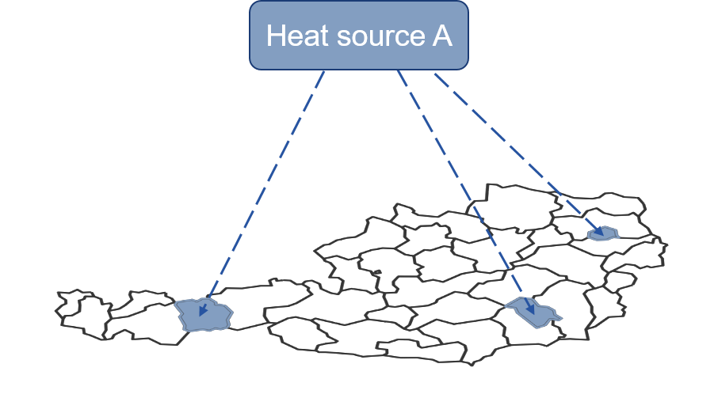
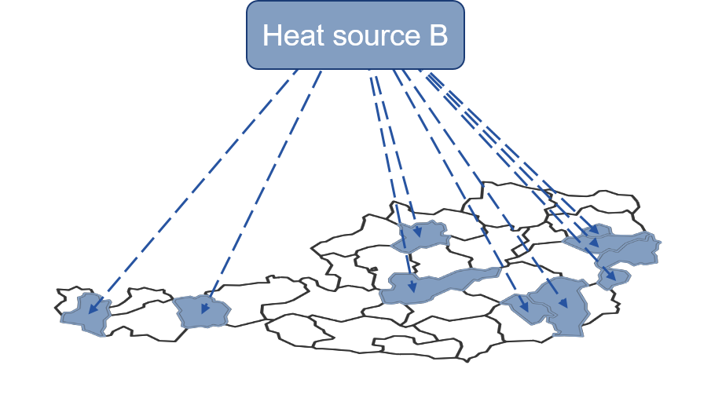
Main concept of the sequential downscaling algorithm
Heat source A has high requirements for heat network infrastructure (e.g., hydrogen)
Heat source B has median requirements for heat network infrastructure (e.g., biomass)
Requirements for heat network infrastructure determine the sub-regions to which is downscaled and the order.
[1]
[2]
[3]
Heat sources without requirements for heat network infrastructure are downscaled last. For example, direct-electric heating is disaggregated to all sub-regions proportionally.

Slide 6
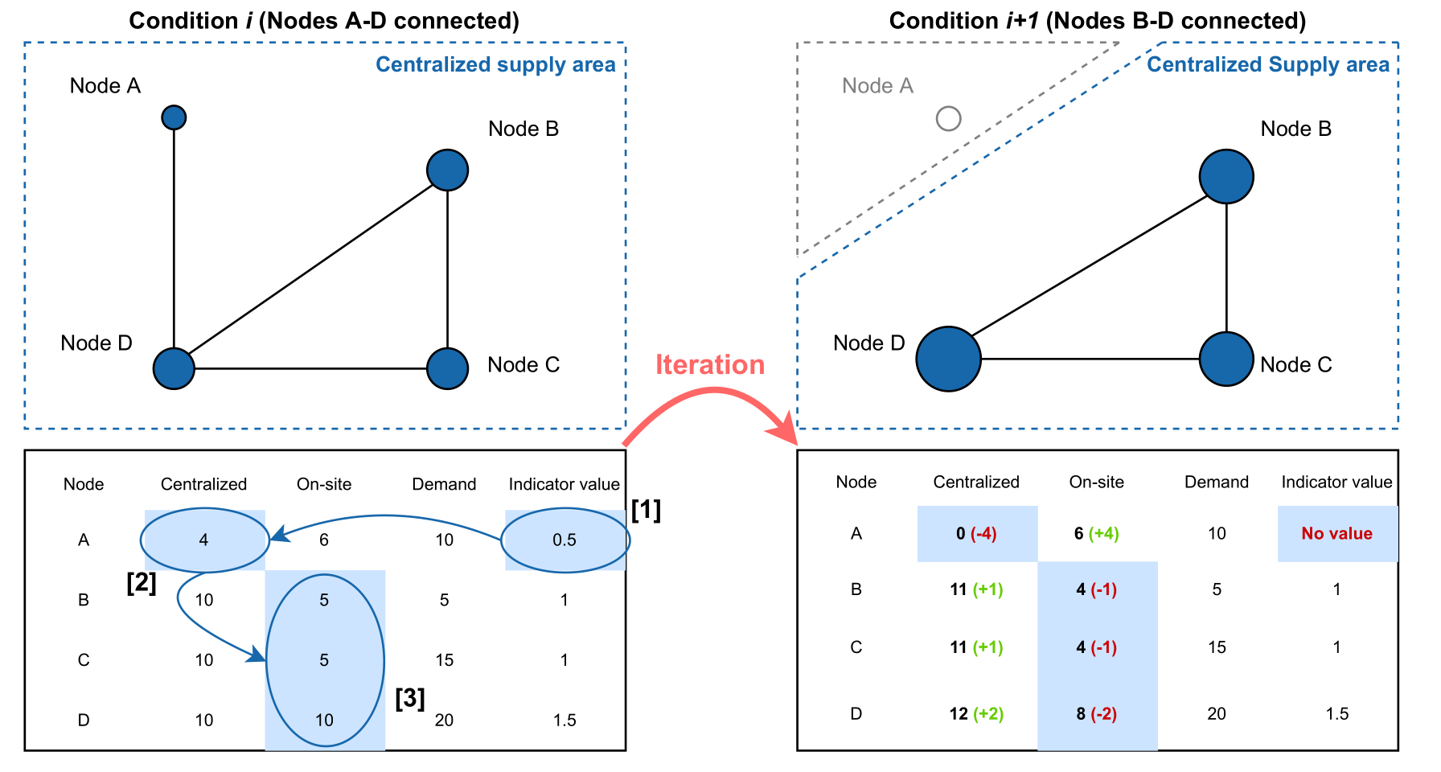

Main concept of the iterative downscaling algorithm
$$c_{n}=\frac{q_{n}}{q_{max}}×\frac{α_{n}}{β_{n}}$$
Cluster(ing) coefficient c =
Indicator value
High connection rate to the centralized heat network at the nodes
Connection of those nodes with a high amount of heat demand and heat density respectively
Cui, Y., Wang, X., & Li, J. (2014). Detecting overlapping communities in networks using the maximal sub-graph and the clustering coefficient. Physica A: Statistical Mechanics and its Applications, 405, 85-91.

Slide 7
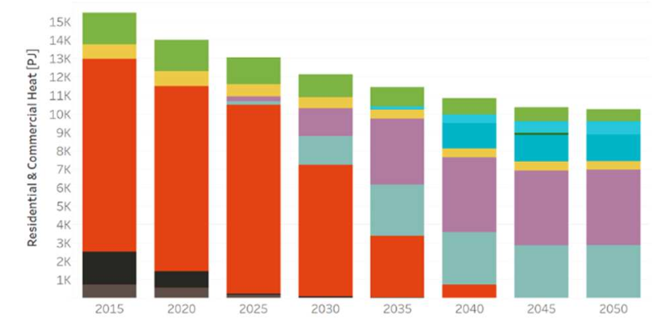
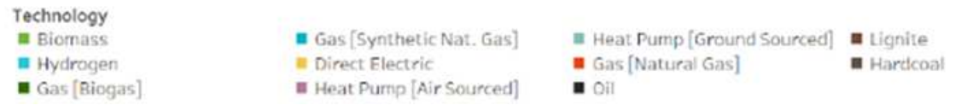
Numerical example and scenarios
Four different decarbonization scenarios of the European energy system aiming for the 1.5/2.0°C global warming climate target¹
Directed Transition scenario (strong policy incentives)
Societal Commitment scenario (strong societal acceptance, decentralized renewables)
Techno-Friendly scenario (market-driven breakthrough of renewables)
Gradual Development scenario (“little of each”)
Values of the decarbonized heating sector in Austria 2050 obtained by the large-numerical energy system model GENeSYS-MOD
c) Techno-Friendly
2050
¹Scenario a) to c) considers the 1.5°C global warming target and d) the less ambitious 2.0°C.
Notes:
We analyze four different decarbonization scenarios of the European energy system considering the 1.5/2°C climate targets. The scenarios are developed in the H2020 project openENTRANCE and cover a wide range of future developments and uncertainties. The four scenarios are named: Directed Transition, Societal Commitment, Techno-Friendly, and Gradual Development. The underlying concept of the scenarios is a three-dimensional space, whereby each scenario emphasizes a strong sustainable development of one dimension. For example, the Directed Transition scenario (a) considers strong policy incentives enabling the sustainable transition. In contrast, the Techno-friendly scenario takes into account a significant market-driven breakthrough of renewables without being dependent on energy policy measures.

Slide 8
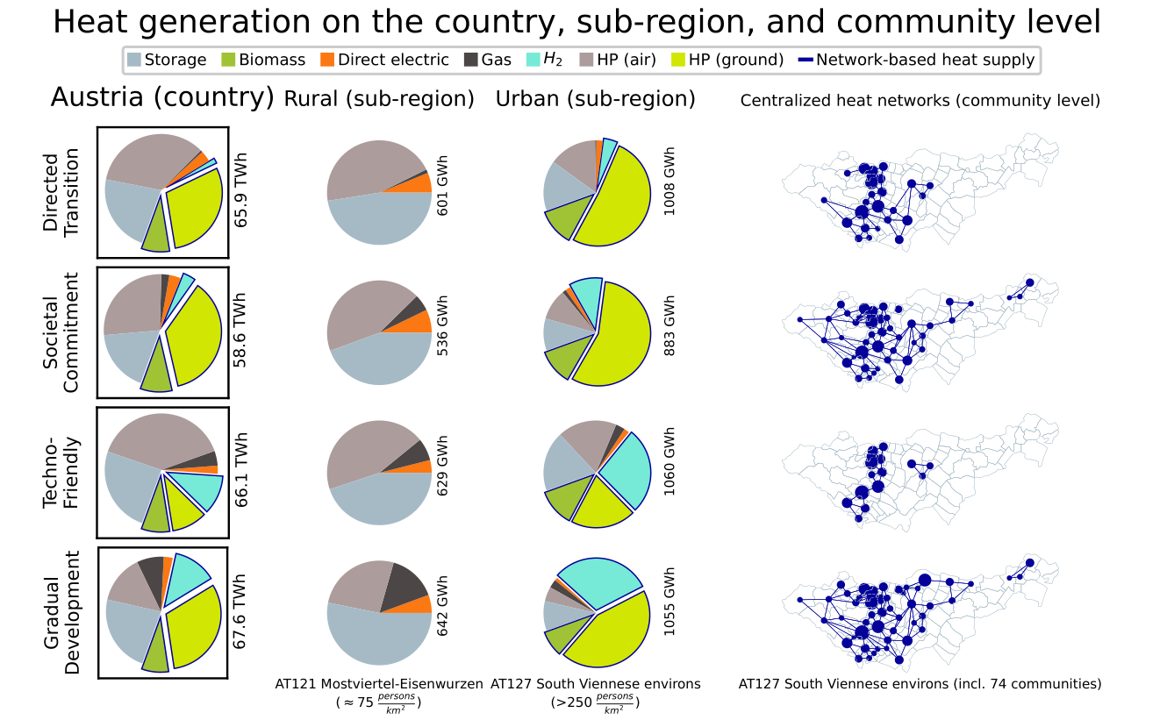
Results (1/4)
Notes:
The following four slide present the highlights of the generated results. First, here we see the heat generation by source on different spatial levels and in the four different scenarios. The heat sources that are prioritized in the district heating network are marked by the blue edge. As you can see, those technologies only supply highly populated areas, whereby rural areas are supplied by direct electric heating, small-scale air-sourced heat pumps and heat storage. The graph on the right shows the district heating network topology. Each point represents the quantity of heat demand supplied by the network. The largest network is obtained in the Gradual development scenario at the bottom right, since this scenario considers the less ambitious 2.0°C global warming target and reduces the total heat demand less than the other scenarios.

Slide 9
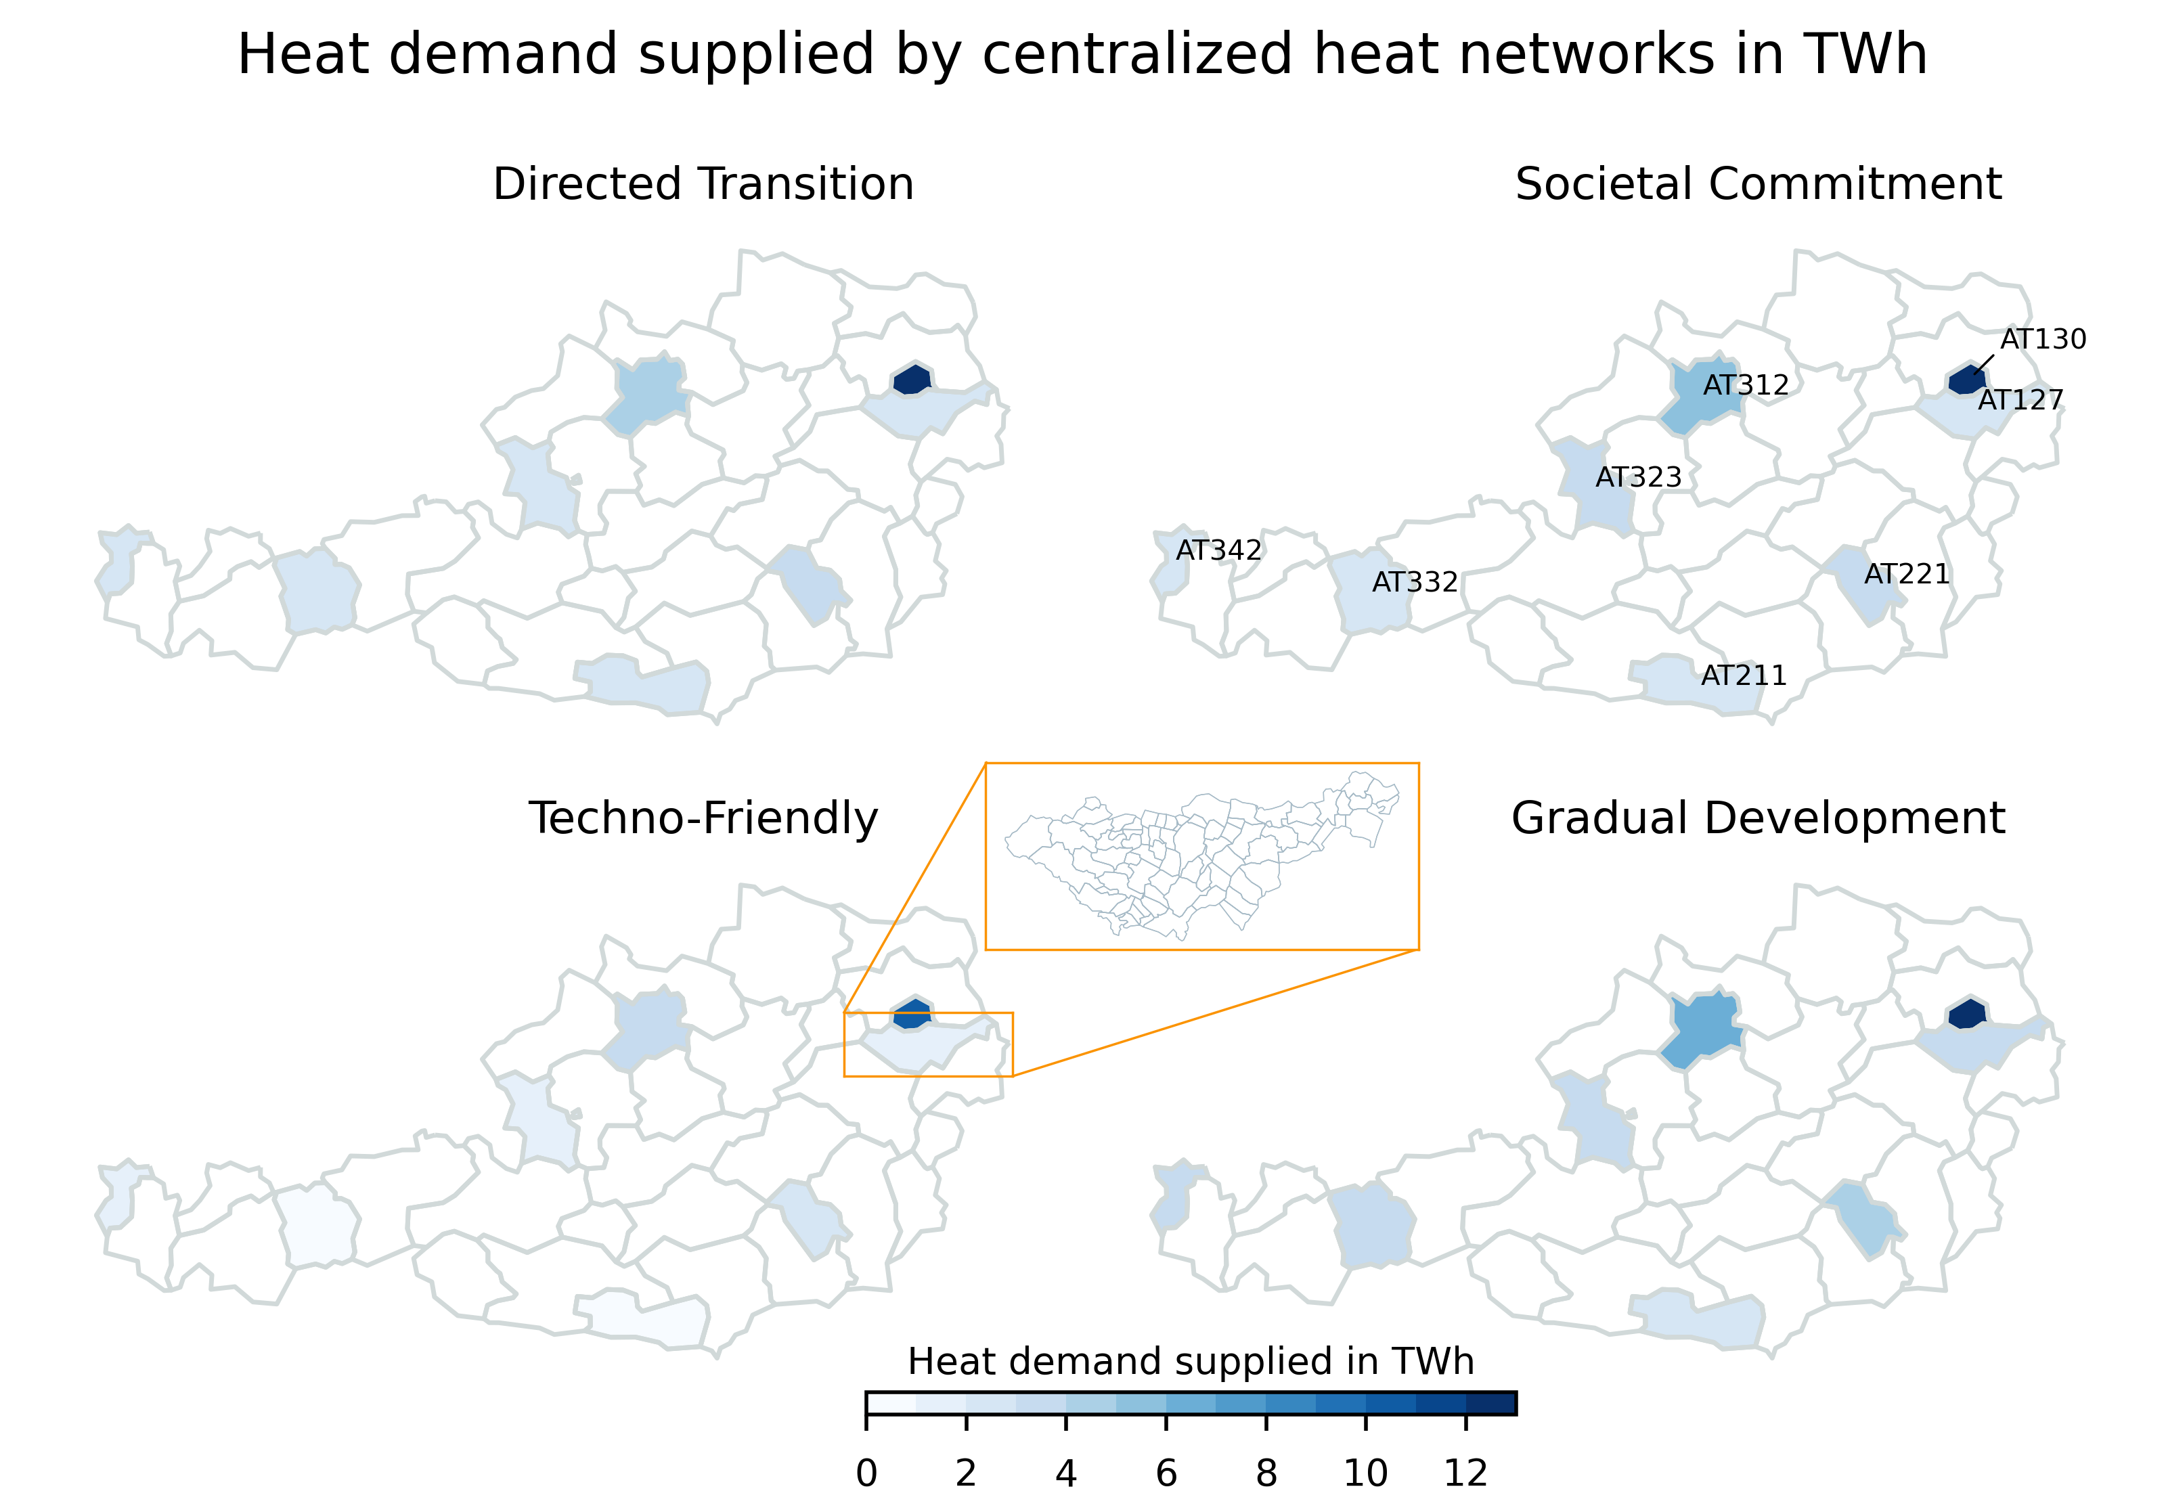
Results (2/4)
Notes:
This heatmap shows the potentials of centralized heat networks 2050 in Austria. As you can see, there are centralized heat networks in six NUTS3 regions. The heat demand supplied by the district heating networks varies among the areas and scenarios between 1.5 and almost 8 TWh. The other sub-regions are supplied by decentralized heating systems as shown in the rural sub-figure on the previous slide. However, obtaining a more realistic estimate of district heating networks in the six sub-regions requires an even finer spatial granularity, as indicated by the orange box. We therefore subjected each of these 6 regions of potential to a further downscaling algorithm that provides more accurate projections of district heating networks based on graph theory benchmarking.

Slide 10
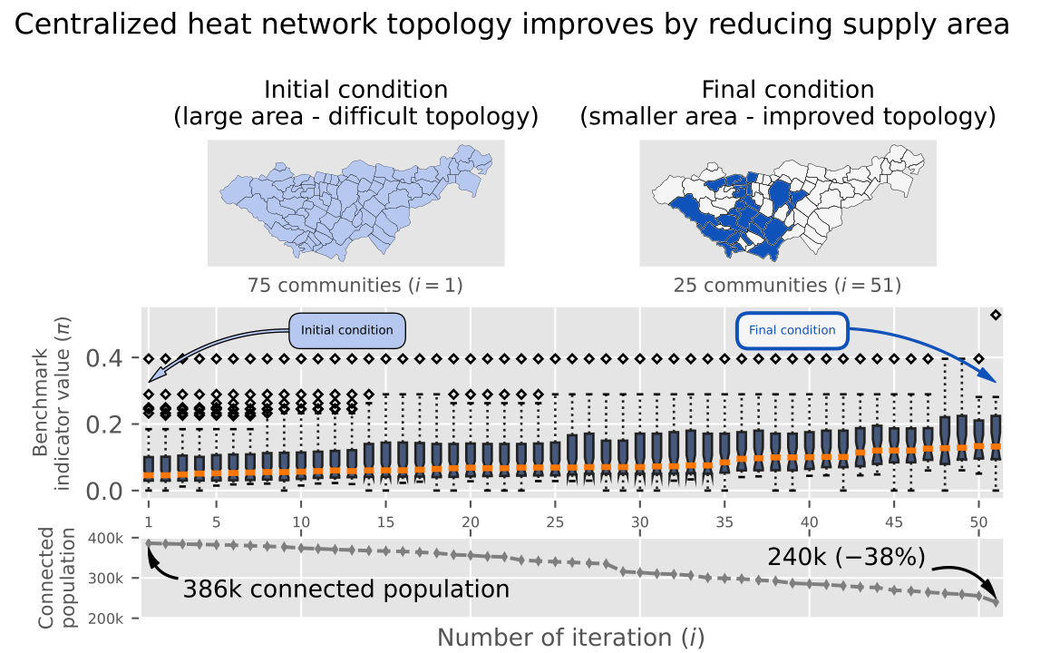
Results (3/4)
Notes:
The example of the NUTS3 region in the orange box is illustrated here. The initial condition means the supply of heat demand in all 75 communities. This large supply area results in a difficult network topology since communities are connected with low heat densities. This results in a low benchmark indicator value of the network. As you can see, our downscaling algorithm improves the network topology by reallocation of the centralized heat supply. The smaller supply area in the final condition has a higher benchmark indicator values and includes 47 communities. The improvement of the network topology results in reduction of the population connected (-13.3%) to the network, as you can see at the bottom right.

Slide 11
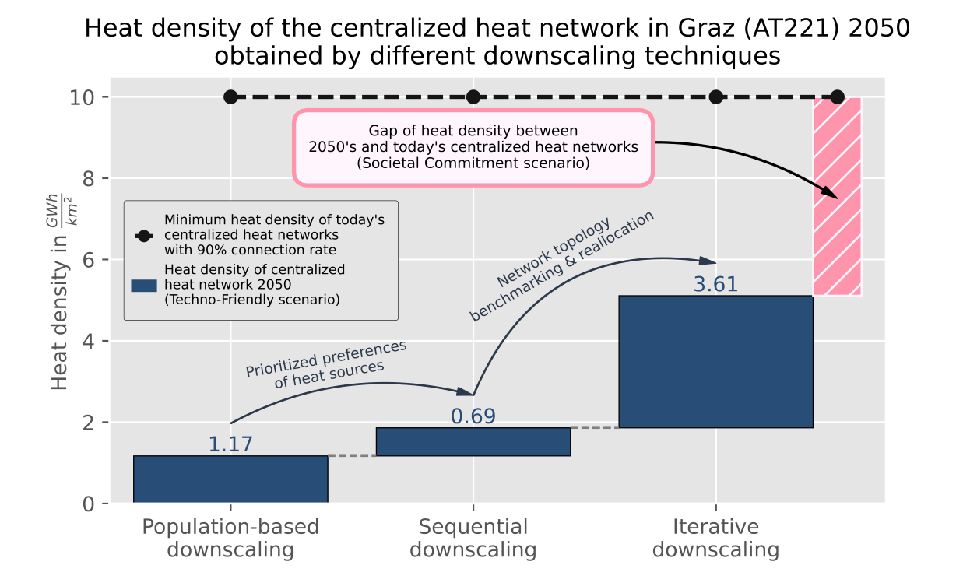
http://www.austrian-heatmap.gv.at/karte/
Results (4/4)
Notes:
This figure shows the heat density of the NUTS3 sub-region Graz 2050 in the Techno-Friendly scenario. As you can see by the waterfall diagram, the different downscaling techniques significantly increase the estimates of the heat density. We obtain for the specific region in the Techno-Friendly scenario a heat density of the district heating network for more than 2.5 GWh per square kilometer. However, the pink bar indicates the gap of heat density between the projection of 2050 and the today’s networks. This gap is the smallest in the Techno-Friendly, why we used this scenario here for the waterfall, and the largest in the Societal Commitment scenario. The difference of the heat density gap between the scenarios is indicated by the gray bar and the different markers.

Slide 12
Conclusions
We found that the prioritized perspective of efficiency and local utilization of renewable heat sources implies substantial changes for the further development of district heating networks in the decarbonized Austrian heat supply toward 2050.
The results demonstrate that particularly densely populated areas are still beneficial supply areas for district heating networks and offer adequate heat densities.
Nevertheless, most district heating networks in 2050 (seven of eight) will not reach the heat density benchmarks of today’s networks and have a significant heat density gap.
However, considering the increasing importance of local renewable heat sources feeding into district heating networks, we assume that these centralized networks will become required in the future and crucial in the decarbonization of the heating sector.
We anticipate our work as a starting point for discussing the role of centralized heat network infrastructure for enabling large-scale, highly efficient and local integration of renewable heat sources such as biomass/waste, hydrogen, ground-sourced heat pumps, or geothermal units.

Slide 13

Acknowledgments / References
Collaborators
Daniel Huppmann (International Institute for Applied Systems Analysis)
Antonia Golab (Energy Economics Group – Technische Universität Wien)
Hans Auer (Energy Economics Group – Technische Universität Wien)
Further references
H. Auer et al. (2020). Development and modelling of different decarbonization scenarios at the European energy system until 2050 as a contribution to achieving the ambitious 1.5°C climate target – establishment of open source/data modelling in the European H2020 project openENTRANCE, e&i Elektrotechnik und Informationstechnik, 1-13. doi: 10.1007/s00502-020-00832-7
This project has received funding from the European Union’s Horizon 2020 research and innovation programme under grant agreement No. 835896

